Slide 1
Box Plots
Prepared by
Sajana Shakya

Slide 2
Definition:
Box plots (also called box-and-whisker plots or box-whisker plots) give a good graphical image of the center of the data, the spread of the data, the distribution of the data and the presence of outliers. It is also called Five – number summary.

Slide 3
Construction of Boxplot: A box plot is constructed from five values. They are
The minimum value
The first quartile, Q1
The median or second quartile, Q2
The third quartile, Q3
The maximum value

Slide 4
Construction of Boxplot: To construct a box plot
use a horizontal or vertical number line and a rectangular box.
The smallest and largest data values label the endpoints of the axis.
The first quartile marks one end of the box and the third quartile marks the other end of the box. Approximately the middle 50 percent of the data fall inside the box.
The “whiskers” extend from the ends of the box to the smallest and largest data values.
The median or second quartile can be between the first and third quartiles.

Slide 5
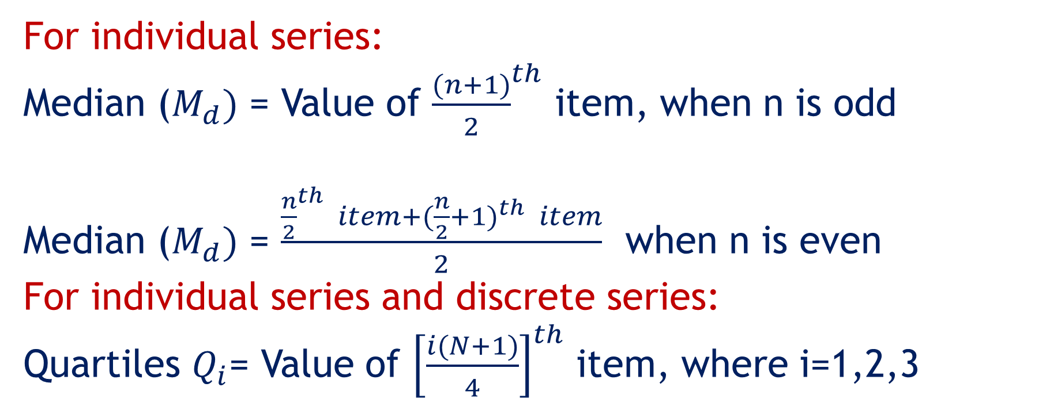
For individual series:
Median ($M_{d})$ = Value of ${\frac{(n+1)}{2}}^{th}$ item, when n is odd
Median ($M_{d})$ = $\frac{{\frac{n}{2}}^{th} item+({\frac{n}{2}+1)}^{th} item}{2}$ when n is even
For individual series and discrete series:
Quartiles $Q_{i}$= Value of ${\left[\frac{i(N+1)}{4}\right]}^{th}$ item, where i=1,2,3

Slide 6
Example:
The following data are the heights of 40 students in a statistics class.
59 60 61 62 62 63 63 64 64 64 65 65 65 65 65 65 65 65 65 66 66 67 67 68 68 69 70 70 70 70 70 71 71 72 72 73 74 74 75 77
Construct a box plot with the following properties
Minimum value = 59
Maximum value = 77
Q1: First quartile = 64.5
Q2: Second quartile or median= 66
Q3: Third quartile = 70

Slide 7
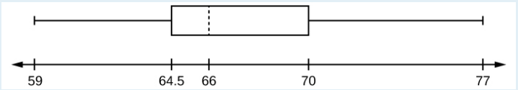
1) Each quarter has approximately 25% of the data.
2) The spreads of the four quarters are
64.5 – 59 = 5.5 (first quarter),
66 – 64.5 = 1.5 (second quarter),
70 – 66 = 4 (third quarter), and
77 – 70 = 7 (fourth quarter).

Slide 8
So, the second quarter has the smallest spread and the fourth quarter has the largest spread.
3) Range = maximum value – the minimum value = 77 – 59 = 18
4) Interquartile Range: IQR = Q3 – Q1
= 70 – 64.5
= 5.5
The middle 50% (middle half) of the data has a range of 5.5 inches.

